Slide 1


Slide 2

Gold
Community Service
Silver
Bronze
Journeys
Notes:
JRA: updated colors to match awards.

Slide 3

You can become a
Gold Award Girl Scout if:
You're a registered Girl Scout Senior or Ambassador
You have completed either:
  One Sr/ Amb Journey AND Silver Award
  Two Sr/Amb Journeys
You are in 9-12th grade (or equivalent)

Slide 4
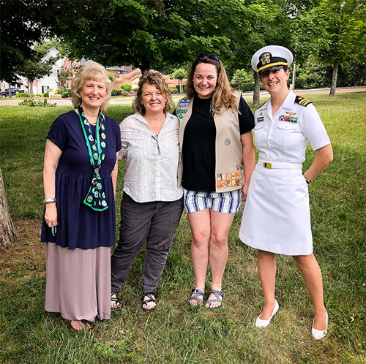

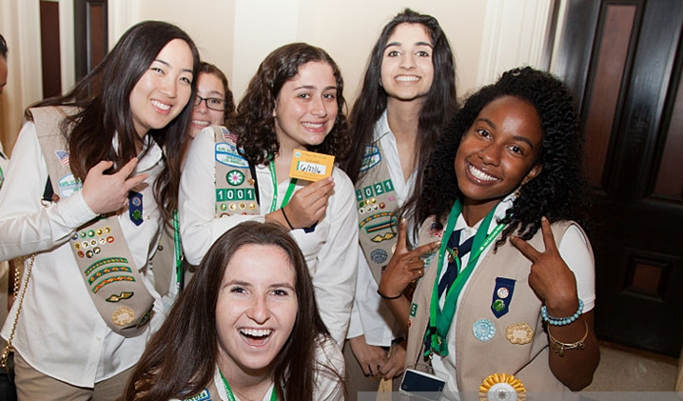
Why Gold?
Be a community leader
Make the world better
College Scholarships
Enter military one rank higher
Personal growth (Lots of it!)

Slide 5
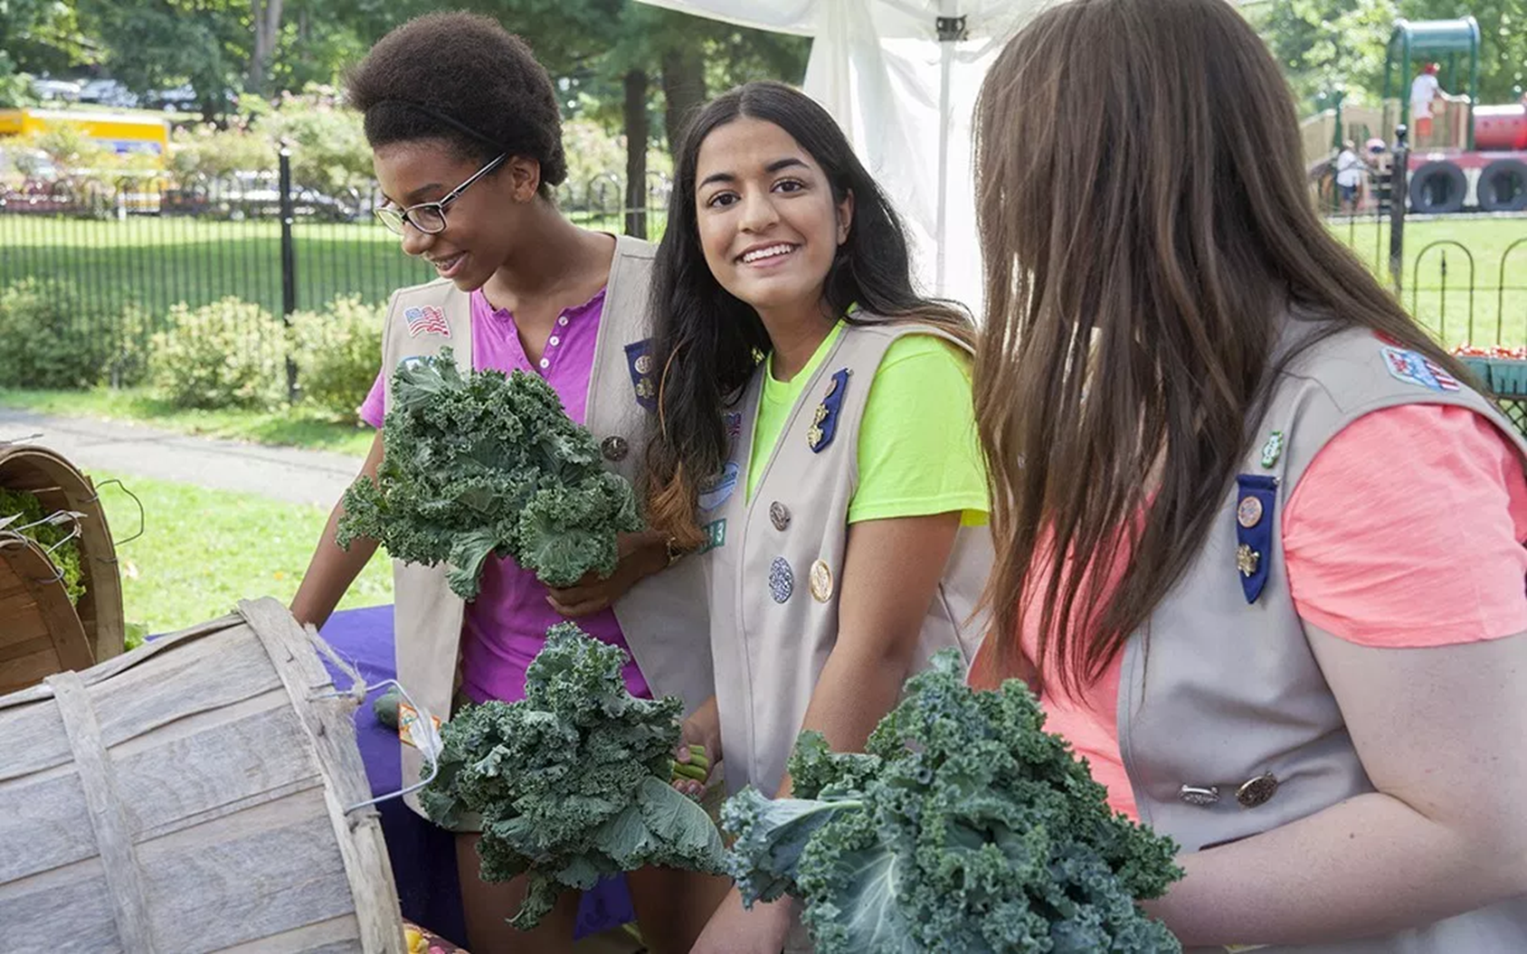
SUCCESS starts with a PLAN
Girl Scout Gold Award Steps:
Identify an issue you care about
Build your team
Explore the national/global community
Refine your project
Develop your plan
Put plan into motion
Reflect, share, and inspire

Slide 6


Leading Solo

Slide 7


Slide 8
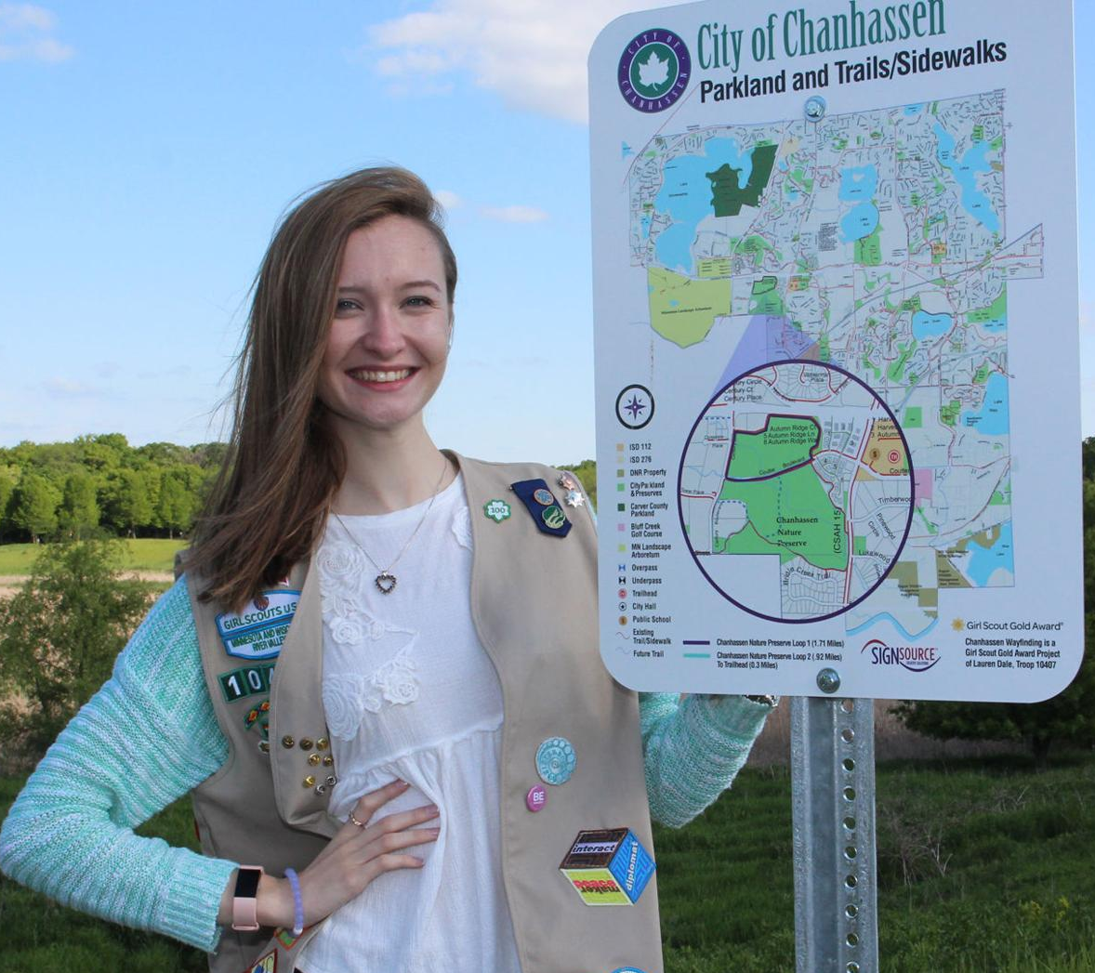
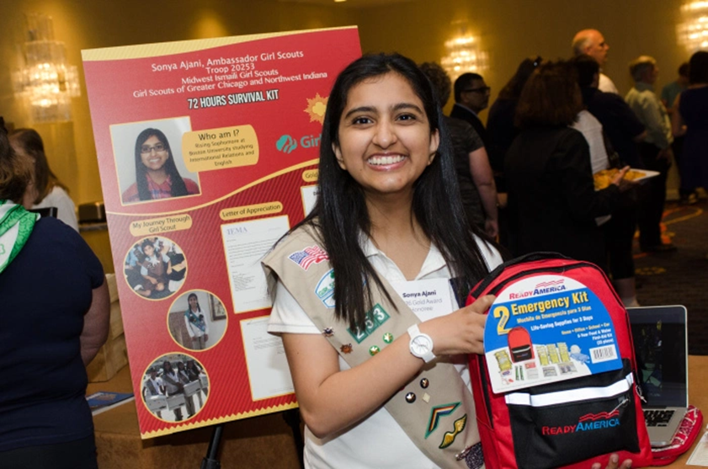
Sustainability
Creates lasting change beyond your involvement, globally
*Laws, education, inspiration
NOT a one-and-done event

Slide 9

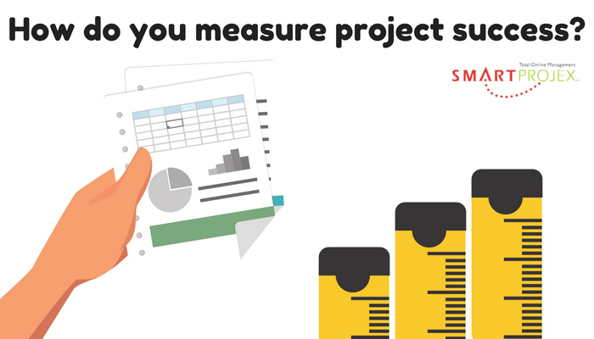
Number of people helped
Reduction in need
Physical addition of items
Community education

Slide 10
Details
GoGold
Usually takes 9-24 months
September 30th
Support team
Committee presentations:
  Proposal presentation (*Before you begin work, research ok)
  Final presentation (*Before Sept. 30, after you graduate)
Notes:
JRA: “times two” instead of x’s 2; spell out year

Slide 11
Each Girl Scout is expected to contribute 80 hours
to the project

Slide 12
Advisor + Mentor
Advisor:
Subject matter expert on your topic
Not a troop leader or guardian
Helps identify resources, solve problems, provide insights
Mentor:
Helps you through the Gold Award process
Assigned by the Gold Award Committee
Checks in monthly to help overcome obstacles, keep on track
Notes:
Kelly Culhane

Slide 13
Complete two Sr./Amb. Journeys OR a Sr./Amb. Journey AND your Silver
Complete Gold Award Training & Quiz
Create a GoGold Account
Take Action
Identify an issue
Educate and Inspire Others
Minimum of 60 hours
Maximum of 20 hours
Investigate it thoroughly
Final Paperwork
Get help/Build a team then create a plan
CELEBRATE!!!
Present your plan/Gather feedback

Slide 14

Define Goal
Plan Steps
Assign Roles
Get Help
Supply List
Consider Funding
Create Timeline
P
L
A
N

Slide 15
Take the Quiz!
https://girlscoutsksheartland.wufoo.com/forms/gold-award-training-quiz/

Slide 16
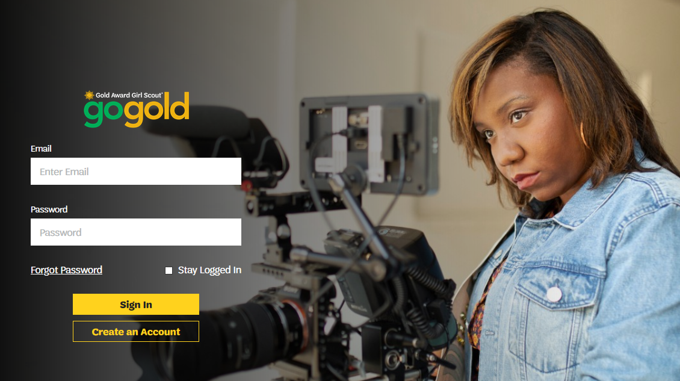

Slide 17
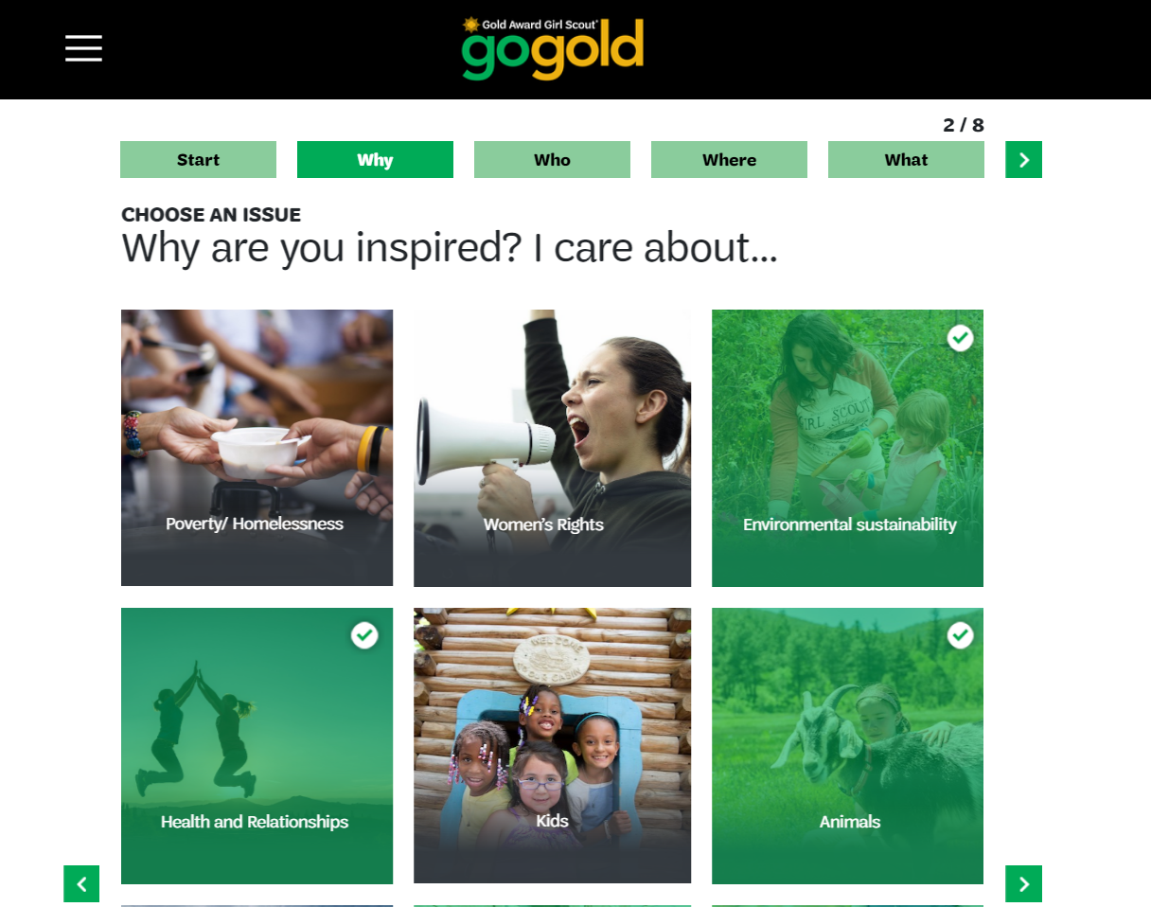

Slide 18
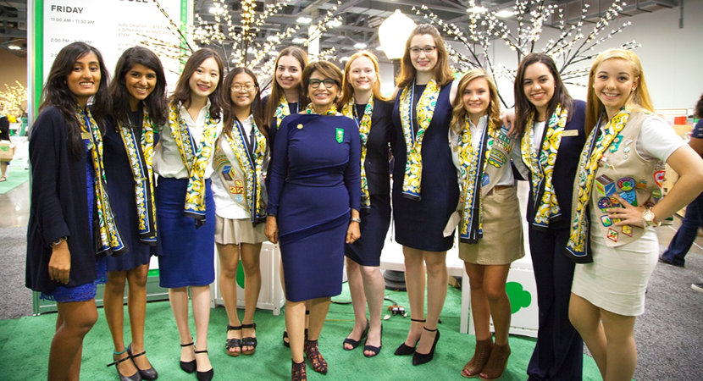
Organized for Success
Know yourself!
How will you ensure you’re staying on track?
Google Calendar
Planner
GoGold
Hour Log
Email
Vision board
Mentor and Advisor

Slide 19
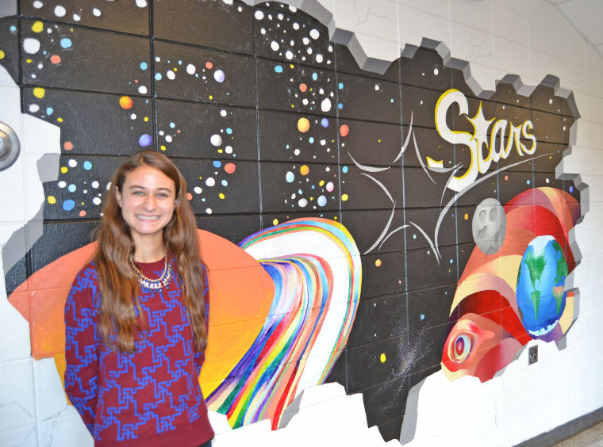
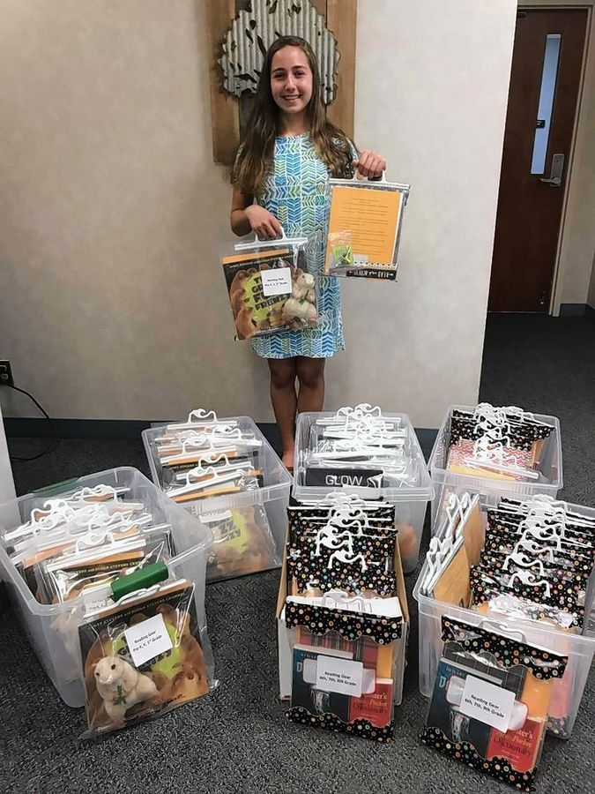
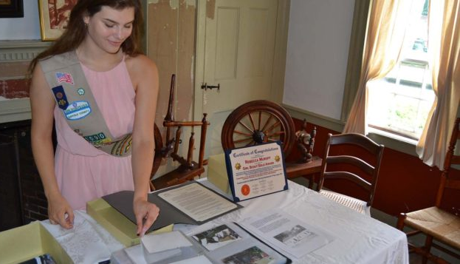
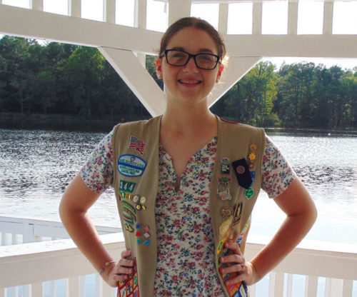
Work on Your Project!
Check in with your Mentor monthly
Take ALL the pictures
Track your hours carefully
Work closely with your Advisor
Use your resources

Slide 20
Keep in Mind
September 30th
Safety Activity Checkpoints
Sustainability: not a one-and-done
It takes time, typically 9-24 months
Final Report (Due 9/30 of after graduation)
Get on the schedule: Gold Committee

Slide 21
Thank You Cards
Reflect
Tell Your Story
Inspire
Social Media
News
Celebrate
Fliers
Instruct
Spread the Word

Slide 22
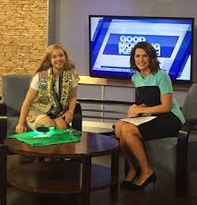
Media
You’re going to be famous for making the world better!
Always contact the Girl Scout council before talking to the media.

Slide 23
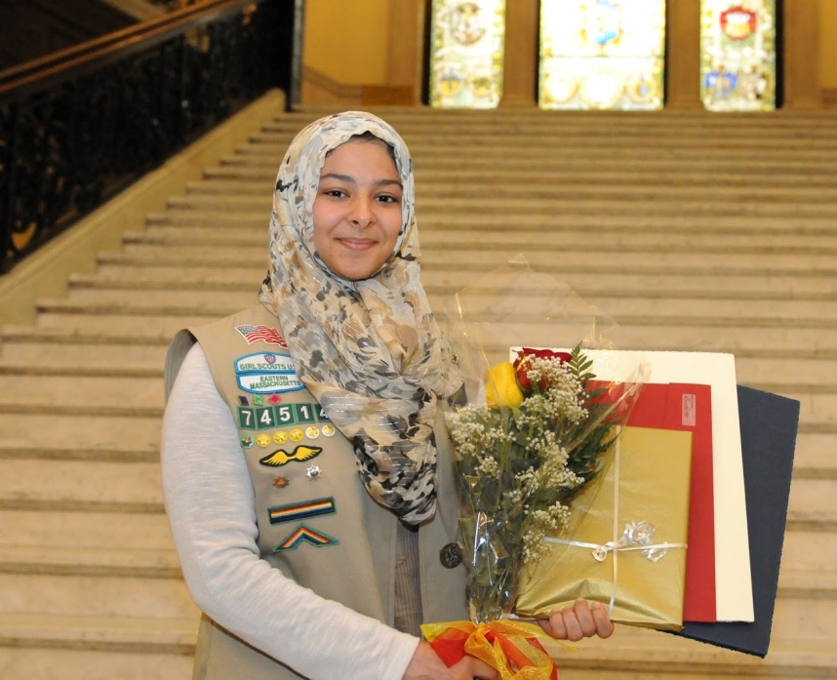
Recognitions:
Gold Award Pin
Letter from the CEO
Gold Award Certificate
Gold Award Honor Cord
Celebration Packet
Plaque presented at Annual Meeting
A place of honor on the Gold Award wall in the main foyer
Press release

Slide 24


