Slide 1



Make the
World
a BETTER place

Slide 2
Gold
Community Service
Silver
Bronze
Journeys
Notes:
JRA: updated colors to match awards.

Slide 3

You can become a
Silver Award Girl Scout if:
You're a registered Girl Scout Cadette
You have completed a Cadette Journey
You are in 6-8th grade (or equivalent)

Slide 4
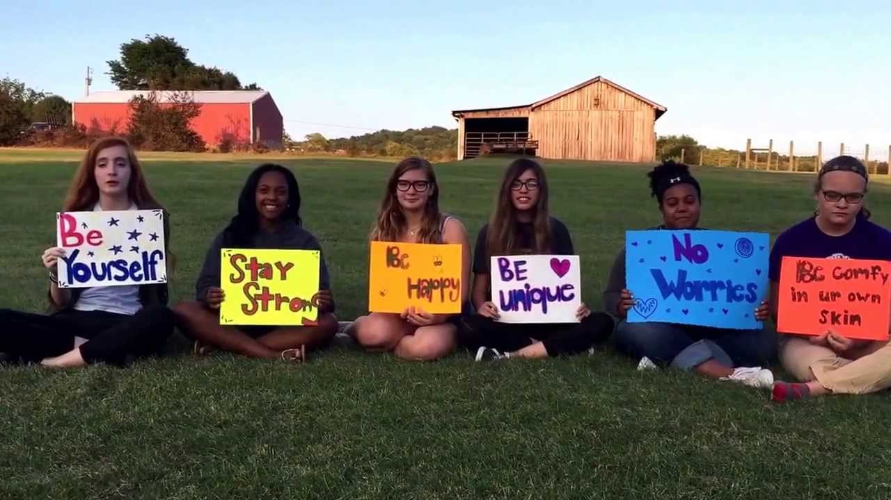
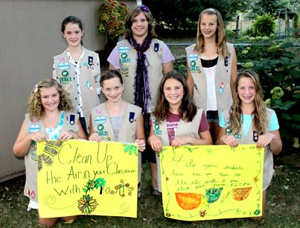
Cadette Journeys
Complete at least one
It’s Your World—Change It!
It’s Your Planet—Love It!
It’s Your Story—Tell It!
Engineering: Think Like an Engineer
Computer Science: Think Like a Programmer
Outdoor STEM: Think Like a Citizen Scientist
Outdoor

Slide 5
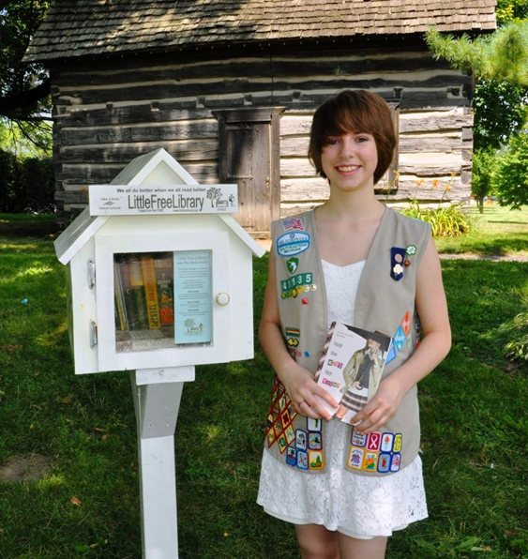
SUCCESS starts with a PLAN
Girl Scout Silver Award Steps:
Identify an issue you care about
Build your team
Explore your community
Refine your project
Develop your plan
Put plan into motion
Reflect, share, and inspire

Slide 6
Girl Led

Slide 7
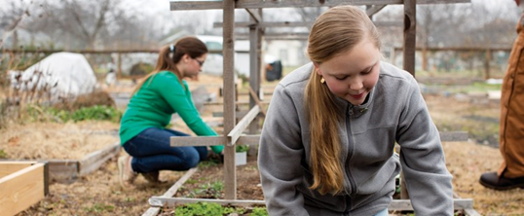
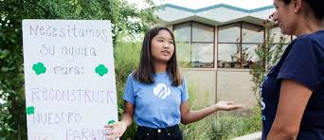
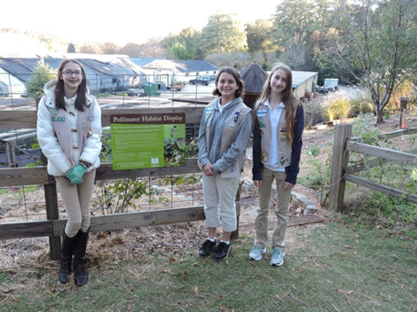
Why Silver?
Leadership
Hard and soft skills
Career Exploration
Makes the world a
better place

Slide 8
Understand the
Root cause
Sustain & Measure
SUCCESS

Slide 9
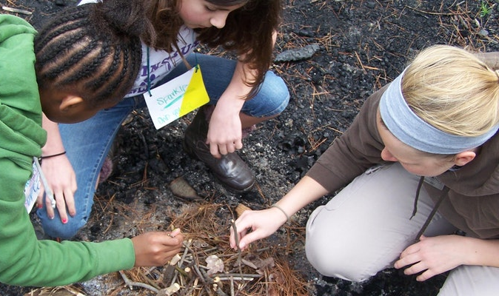
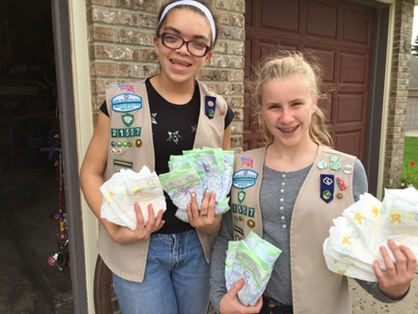
Sustainability
Creates lasting change beyond your involvement
*Laws, education, inspiration
NOT a one-and-done event

Slide 10
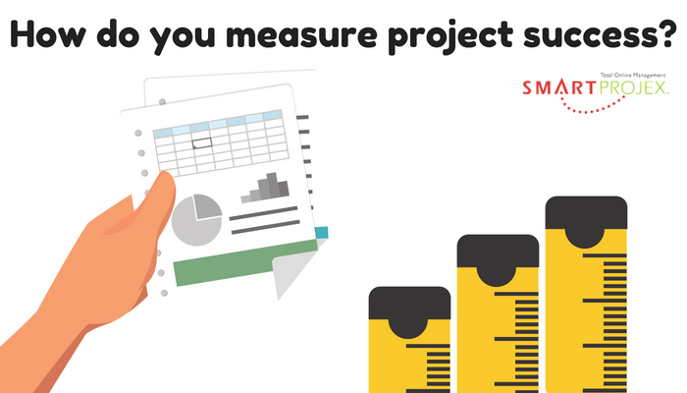
Number of people helped
Reduction in need
Physical addition of items
Community education

Slide 11
Details
1-3 girls per project
Usually takes 6-15 months
September 30th
Committee presentations:
  Proposal presentation (*Before you begin work, research ok)
  Final presentation (*Before Sept. 30 of your Freshman year)
Notes:
JRA: “times two” instead of x’s 2; spell out year

Slide 12
Each Girl Scout is expected to contribute 50 hours
to the project

Slide 13
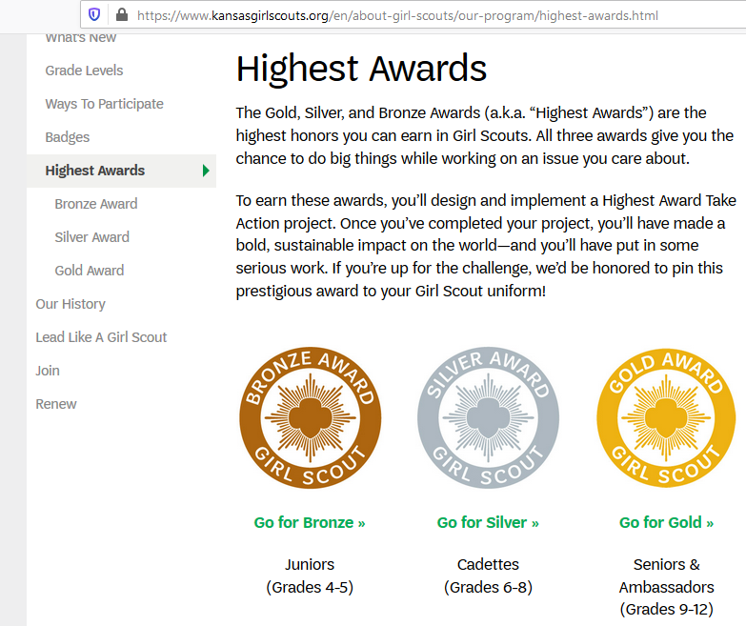
Paperwork
Hour Log
Budget Worksheet
Silver Proposal
Money Earning App.
Silver Final Report
Notes:
JRA: added “report”

Slide 14

Define Goal
Plan Steps
Assign Roles
Get Help
Supply List
Consider Funding
Create Timeline
P
L
A
N

Slide 15
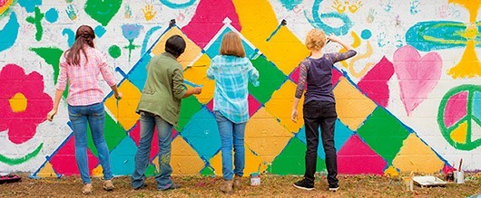
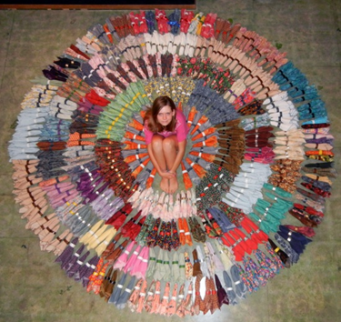
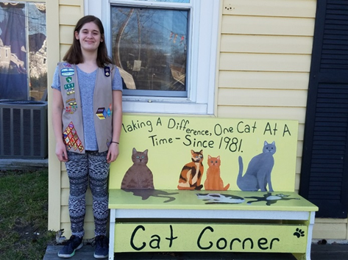
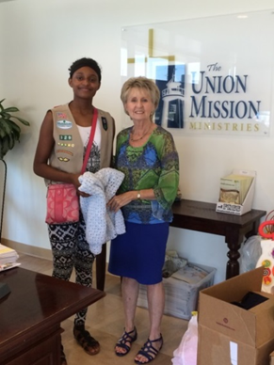
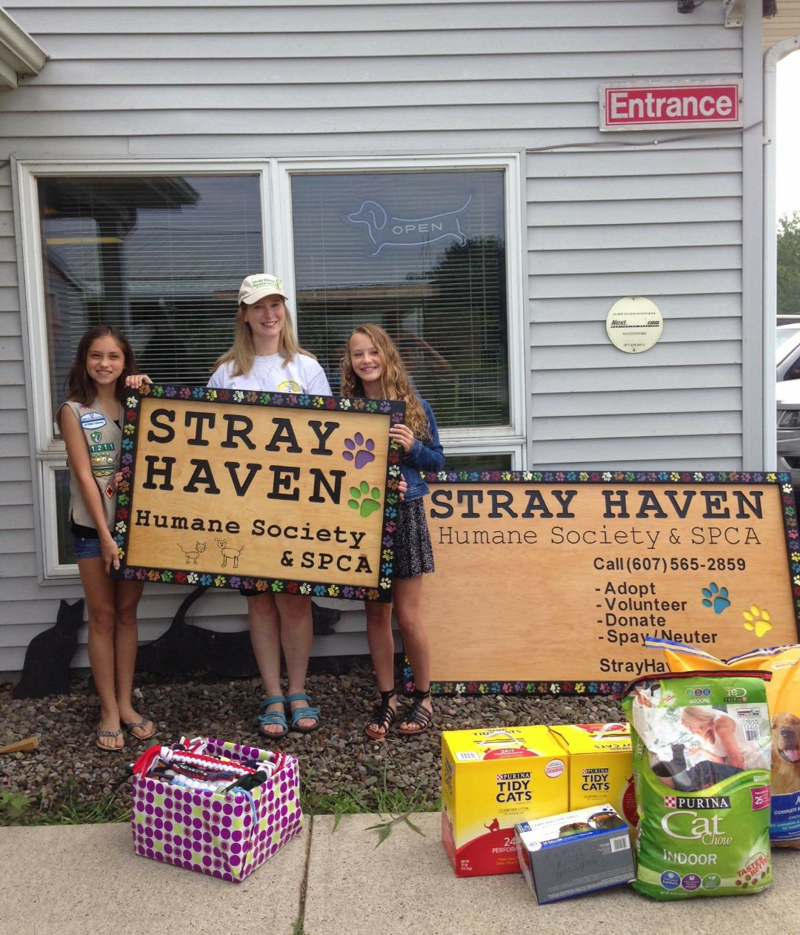
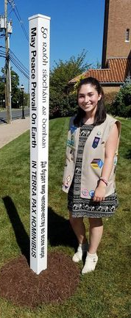
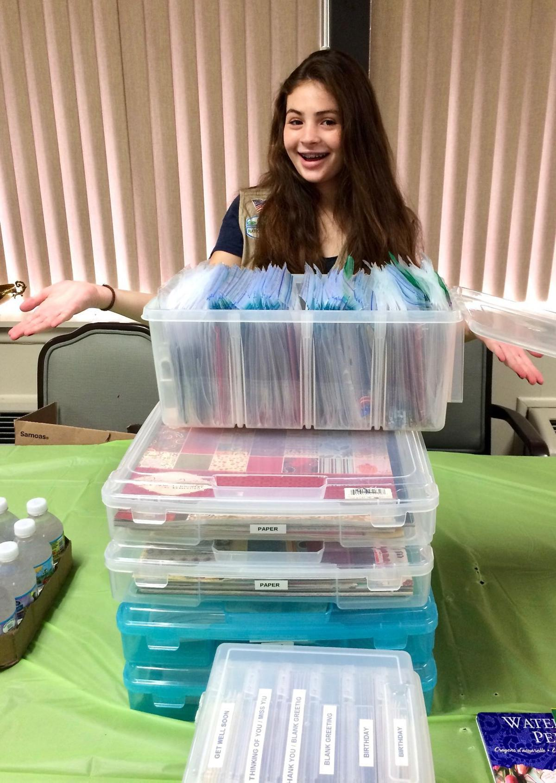
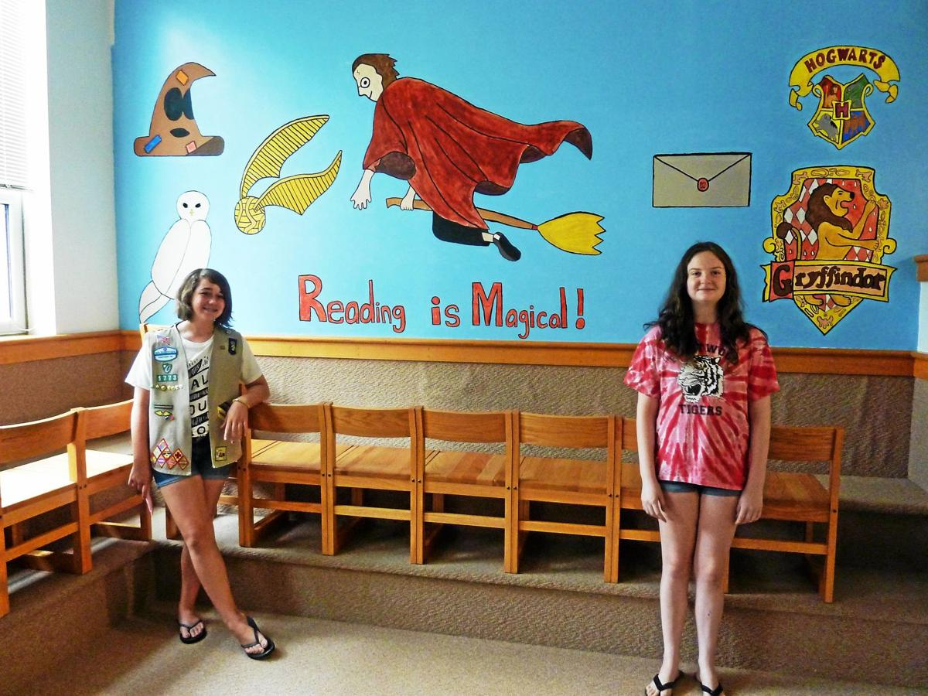
Complete Your Project!

Slide 16
Thank You Cards
Reflect
Tell Your Story
Inspire
Social Media
News
Celebrate
Fliers
Instruct
Spread the Word

Slide 17
Keep in Mind
September 30th
Safety Activity Checkpoints
Sustainability: not a one-and-done
It takes time, typically 6-15 months
Final Report (Due 9/30 of 9th grade yr)
Get on the schedule: Silver Committee

Slide 18

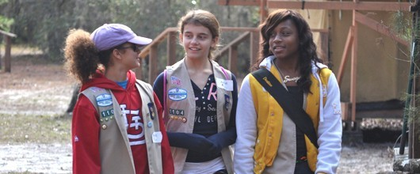
What do Silver Award GS say?
Don’t procrastinate
Scheduling is hardest
Plan and plan more
Ask for help

Slide 19
How will you grow
Build Connections
Explore Strengths
This is for you
Career exploration

Slide 20
FAQs:
Due Date? September 30th
Council provides certificates and pins
Cannot “double-dip” hours with other awards
Silver can be a continuation of Bronze BUT must be substantially more impactful
50 hours each- hour log

Slide 21

Will you go for
Gold?

