Slide 1
Make the
World
a BETTER place

Slide 2
Gold
Community Service
Silver
Bronze
Journeys
Notes:
JRA: I updated the colors to match the award.

Slide 3
You can become a
Bronze Award Girl Scout if:
You're a registered Girl Scout Junior
You have completed a Junior Journey
You are in 4th or 5th grade (or equivalent)

Slide 4
Junior Journeys
Complete at least one
Notes:
JRA: Also the Outdoor Journey – 7 options total

Slide 5
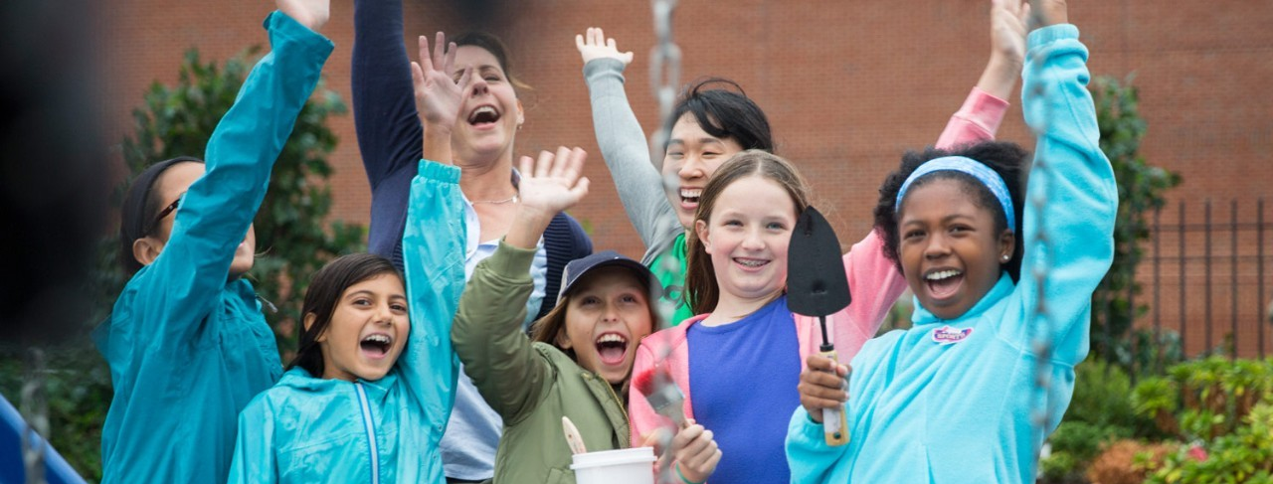
SUCCESS starts with a PLAN
Girl Scout Bronze Award Steps
Build your Girl Scout Junior team
Explore your community
Choose your Bronze Award project
Make a plan
Put your plan in motion
Spread the word

Slide 6
Girl Led

Slide 7
Get to know your team’s strengths and ways each person can grow
Have a clear goal
Celebrate talents, interests, and resources
TEAMWORK

Slide 8
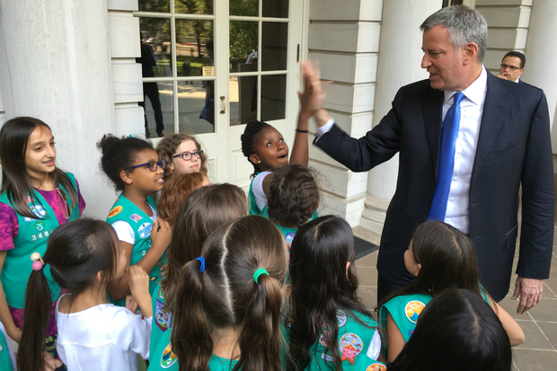
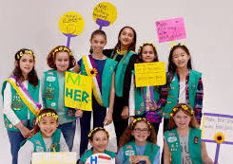
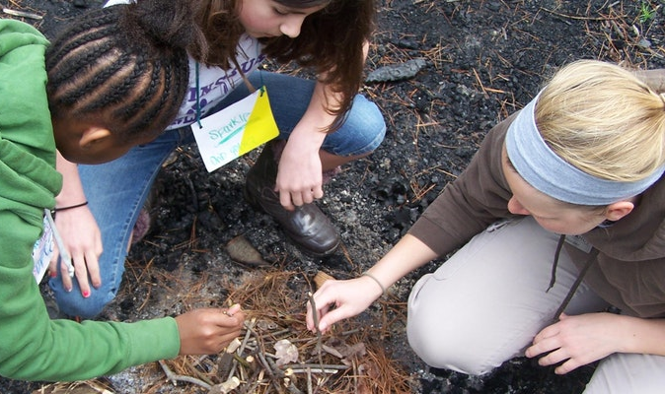
Explore
Explore your community by:
Observing
Researching
Brainstorming

Slide 9
Which project does your team choose?
Get the facts- experts
Take notes
Narrow down ideas
Choose

Slide 10
Define Goal
Plan Steps
Assign Roles
Get Help
Supply List
Consider Funding
Create Timeline
P
L
A
N

Slide 11
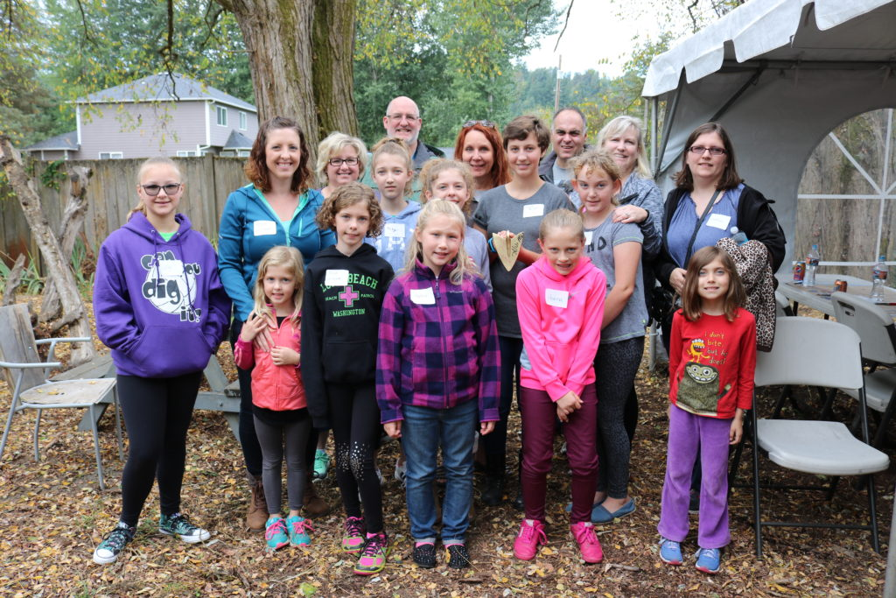
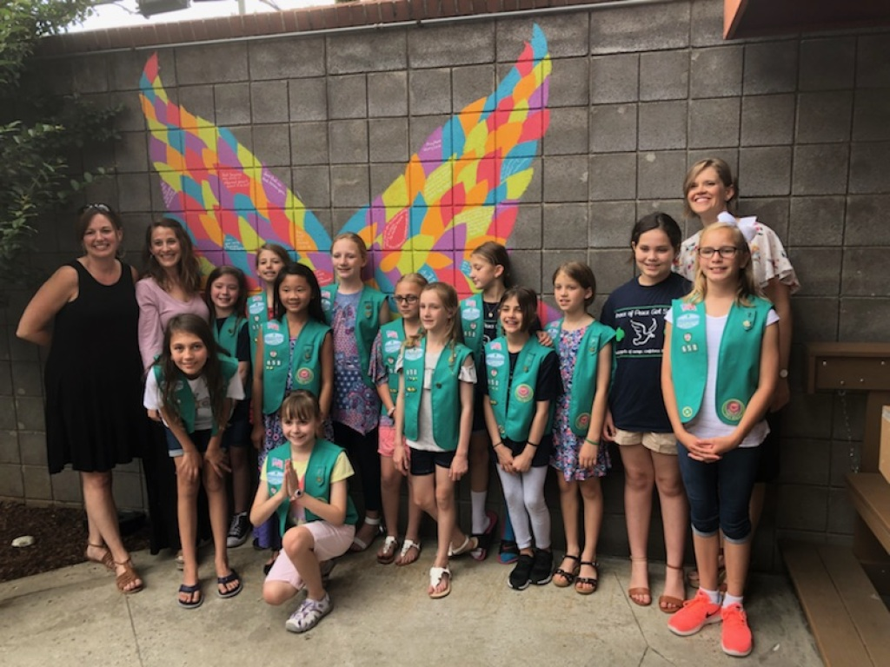
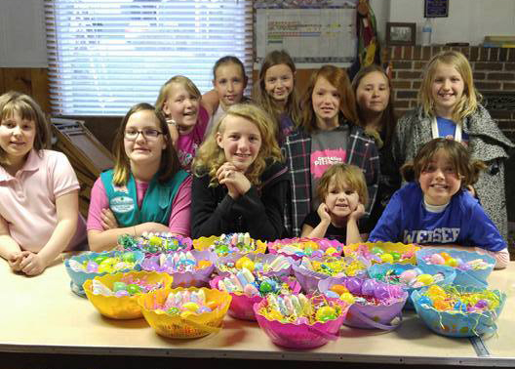
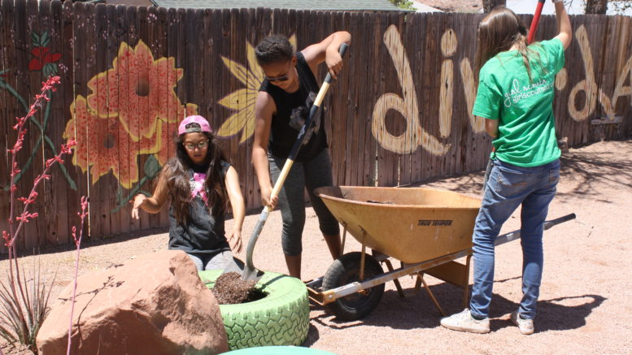
Complete Your Project!

Slide 12
Thank You Cards
Reflect
Tell Your Story
Inspire
Social Media
News
Celebrate
Fliers
Instruct
Spread the Word

Slide 13
Each Girl Scout is expected to contribute 20 hours
to the project

Slide 14
It’s on the Website
Bronze Award Report

Slide 15
Keep in Mind:
September 30th
Safety Activity Checkpoints
Sustainability: not a one-and-done
It takes time, typically 3-6 months
Final Report (Due 9/30 of 6th grade yr)

Slide 16
FAQs:
Due Date? September 30th
Council provides certificates, you purchase pins
How many can work on one project? As many as you want (*leadership roles)
No prior approval needed

Slide 17
Will you go for
Gold?

